Slide 1
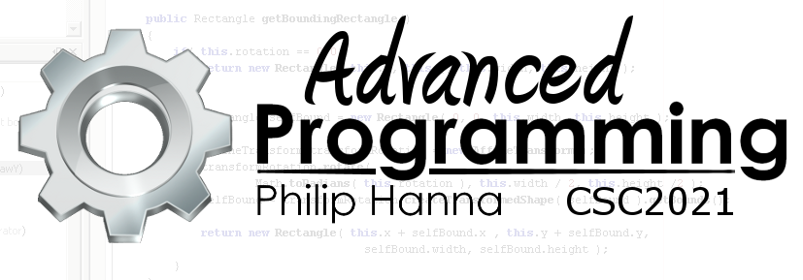
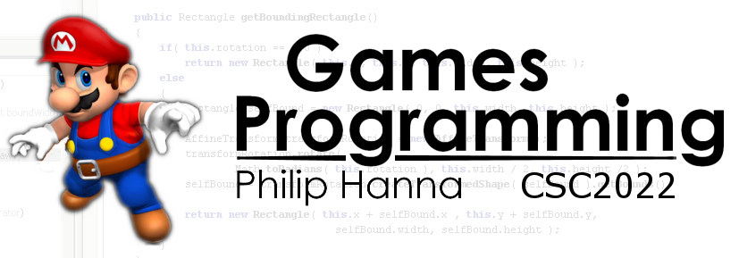
AI Aiming
Enabling AI entities to target and aim

Slide 2
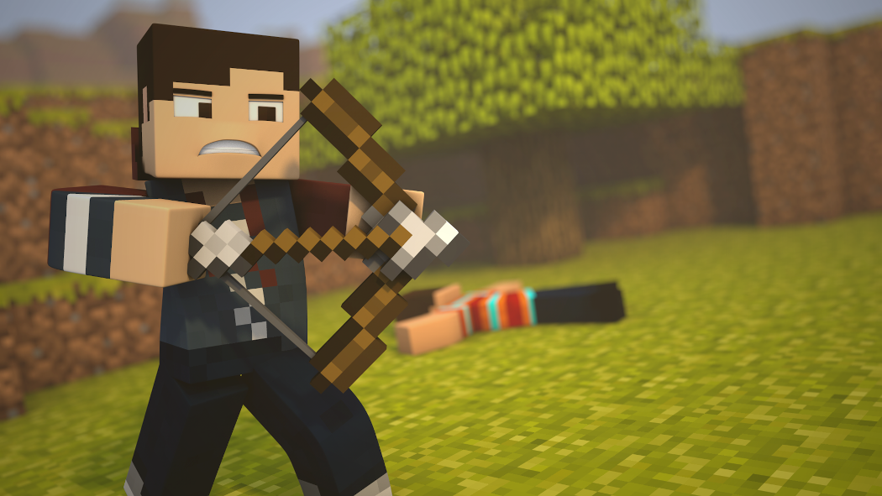
Aiming and Firing

Slide 3

A lot of games involve projectiles of some sort (be they arrows, missiles, footballs, etc.).
It can be important for an AI controlled character to ‘understand’ the projectile’s trajectory in order to aim or react to incoming projectiles

Slide 4
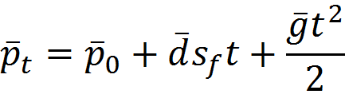
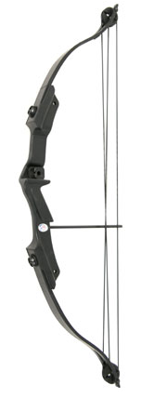



: Project Trajectory
A projectile fired with an initial force that is subject to a gravitational force (ignoring air resistance and powered projectiles, e.g. rockets) will follow a curved trajectory (a parabola).
The path can be defined as:
is the position at time t
is the initial position
is the initial direction of firing
is the speed of firing
is the gravitational vector
Initial position
movement due to firing
movement due to gravity
Aside: Earth’s gravitational force is 9.81 ms-2 ‘downwards’. This may not be the best value for a game, i.e. experiment with different values.

Slide 5
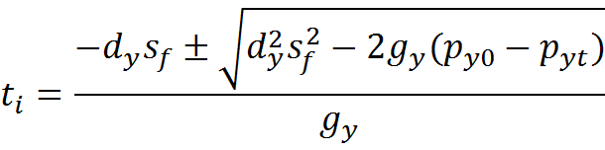


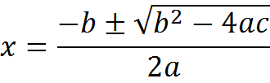
: Landing Position
The landing spot is found by solving for a given ‘floor’ height for the target (i.e. the y vector component).
is the y component of the direction of firing, gravity, position at time 0 and time t respectively.
There can be 0, 1 or 2 solutions. If zero, the projectile never reaches the target. If one, it reaches it at the apex of travel.
If there are two solutions, target height is reached on way up and way down (the later projectile descending is of interest).
Aside: This is a quadratic equation which can be solved using:

Slide 6
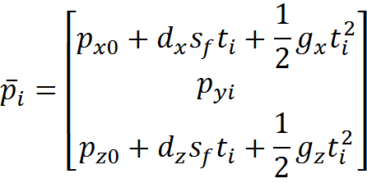
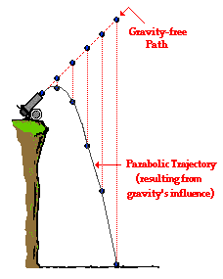
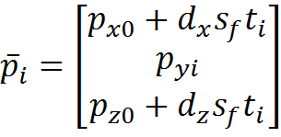
: Landing Position
Substituting the solution time into the trajectory equation of the point, the point of collision is found by (in 3D, for 2D remove z component):
Aside: As gravity is often only along the y-axis the equation
can be simplified
to:

Slide 7
: Firing Direction
In order to hit a target at a specific location the previous equation is solved for a target location.
The firing location will be known and often gravitational attraction and initial firing speed are assumed to be fixed, i.e. the direction of firing is varied in order to hit the target location.
Aside: Usually there will be two solutions representing different firing arcs to the target. Typically the arc with the lower time is selected.
Long-term trajectory
Target
Short-term trajectory

Slide 8
Vector? calculateFiringSolution(
Vector start, Vector target, Vector gravity, float speed ) {
Vector delta = start – end;
float a = gravity ● gravity;
float b = -4 * (gravity ● delta + speed * speed)
float c = 4 * delta ● delta
if( 4*a*c > b*b ) return null;
float t1 = Math.sqrt((-b + sqrt(b*b-4*a*c)) / (2*a));
float t2 = Math.sqrt((-b - sqrt(b*b-4*a*c)) / (2*a));
float t;
if( t1 < 0 ) {
if( t2 < 0 ) return null; else t = t1;
} else {
if( t2 < 0 ) t = t1; else t = Math.min( t1, t2 );
}
return (2 * delta – gravity * t*t) / (2 * speed * t);
: Aiming Algorithm
Calculate (a,b,c) coefficients of the normal quadratic equation
The dot product of two vectors, i.e. A●B is A_{x}B_{x} + A_{y}B_{y} +...
Return if no real solutions are found
Determine the two solutions
Return null if no positive time solutions were found
Return firing vector

Slide 9

Key takeaways:
Aiming and firing solutions provide a means of enabling AI agents to direct a projectile towards a specified target or to determine if an incoming projectile will hit.

